Slide 1
C22 Conservation
IGCSE Biology
Wendy Chai

Slide 2

Sustainable resources
Sustainable development
Conserve resource - recycle
Conserve resource - sewage treatment
Conserve resource - conserve forests
Conserve resource - conserve fish stocks
Conserve species

Slide 3
Sustainable resources
Sustainable resource is the ones that can be removed from the environment without it running out. Should be replenished, long term available.
E.g.
1) wind, solar energy, water, soil, air, geothermal energy;
2) trees/ forestry; 3) agricultural products;
4) animals; 5) fishery (can be sustainable or non-sustainable)
The United States National Oceanic and Atmospheric Administration reports that of the 187 commercially valuable fish species it tracks, more than 40 were harvested beyond a point of sustainability. With the proper policies in place, however, fisheries can sustain themselves.
Notes:
Renewable and sustainable resources are not the same thing. Unlike a renewable resource, a sustainable one does not have to be replenished quickly, as long as it is consumed slowly. (wiseGEEK)
Sustainability takes into account how we might live in harmony with the natural world around us, protecting it from damage and destruction.

Slide 4

Sustainable energy
All renewable energy (also called alternative energy) sources like solar, wind, geothermal, hydropower, wave and tidal power (also called marine energy) are forms of sustainable energy. Biomass energy and hydrogen energy are also sustainable energy.
Renewable energy projects require huge capital and so far have produced only small amount of world’s energy consumption. It will take almost decades and some positive steps so that renewable energy has a major share in total energy output.
Non-renewable energy: fossil fuel (coal, oil, natural gas), Nuclear energy
Around 16% of world’s electricity production comes through nuclear energy. Nuclear power plants use Uranium as a fuel to extract energy from it.
Most of the times these two terms, sustainable energy and renewable energy are used interchangeably.
Notes:
Sustainable energy is the practice of using energy in a way that "meets the needs of the present without compromising the ability of future generations to meet their own needs. These sources must be used cautiously so that they will not be used up, run out, or otherwise become unusable.
All energy sources which can be naturally replenished are considered to be renewable energy sources. However, if the rate of use exceeds the rate of renewal - that is, the source is used more than it's being recreated - its continued use will become unsustainable.
Most of the times these two terms are used interchangeably. Renewable energy includes all those sources that do not cause any harm to environment and have minimal impact on the surrounding environment. Sustainable is much more a wider term.
Sources such as solar, wind, geothermal, hydropower, wave, tidal and hydrogen are renewable as well as sustainable since they have minimum impact on the environment whereas Nuclear energy or nuclear power is not considered as renewable but it is sustainable as it pollutes the environment.
Even renewable resources can become unsustainable. If a resource is used up faster than it can regenerate, it will eventually be entirely depleted despite its renewability.
Resources are considered non-renewable if they take a very long time to be created (e.g. fossil fuels) or if their creation happened long ago and is not likely to happen again (e.g. uranium). Flows are almost always renewable. On the other hand, biofuels are renewable and definitely count as fuels.
Though coal is still available in big quantity on this earth but it is predicted that it won’t last for more than 40-50 years if switch is not made to green or clean energy.
Natural gas is a mixture of several gases including methane, ethane, propane and butane.
Nuclear power plants produce some sort of nuclear waste called radioactive elements.
These elements emit strong radiations and must be buried deep underground so that they don’t affect human life.

Slide 5
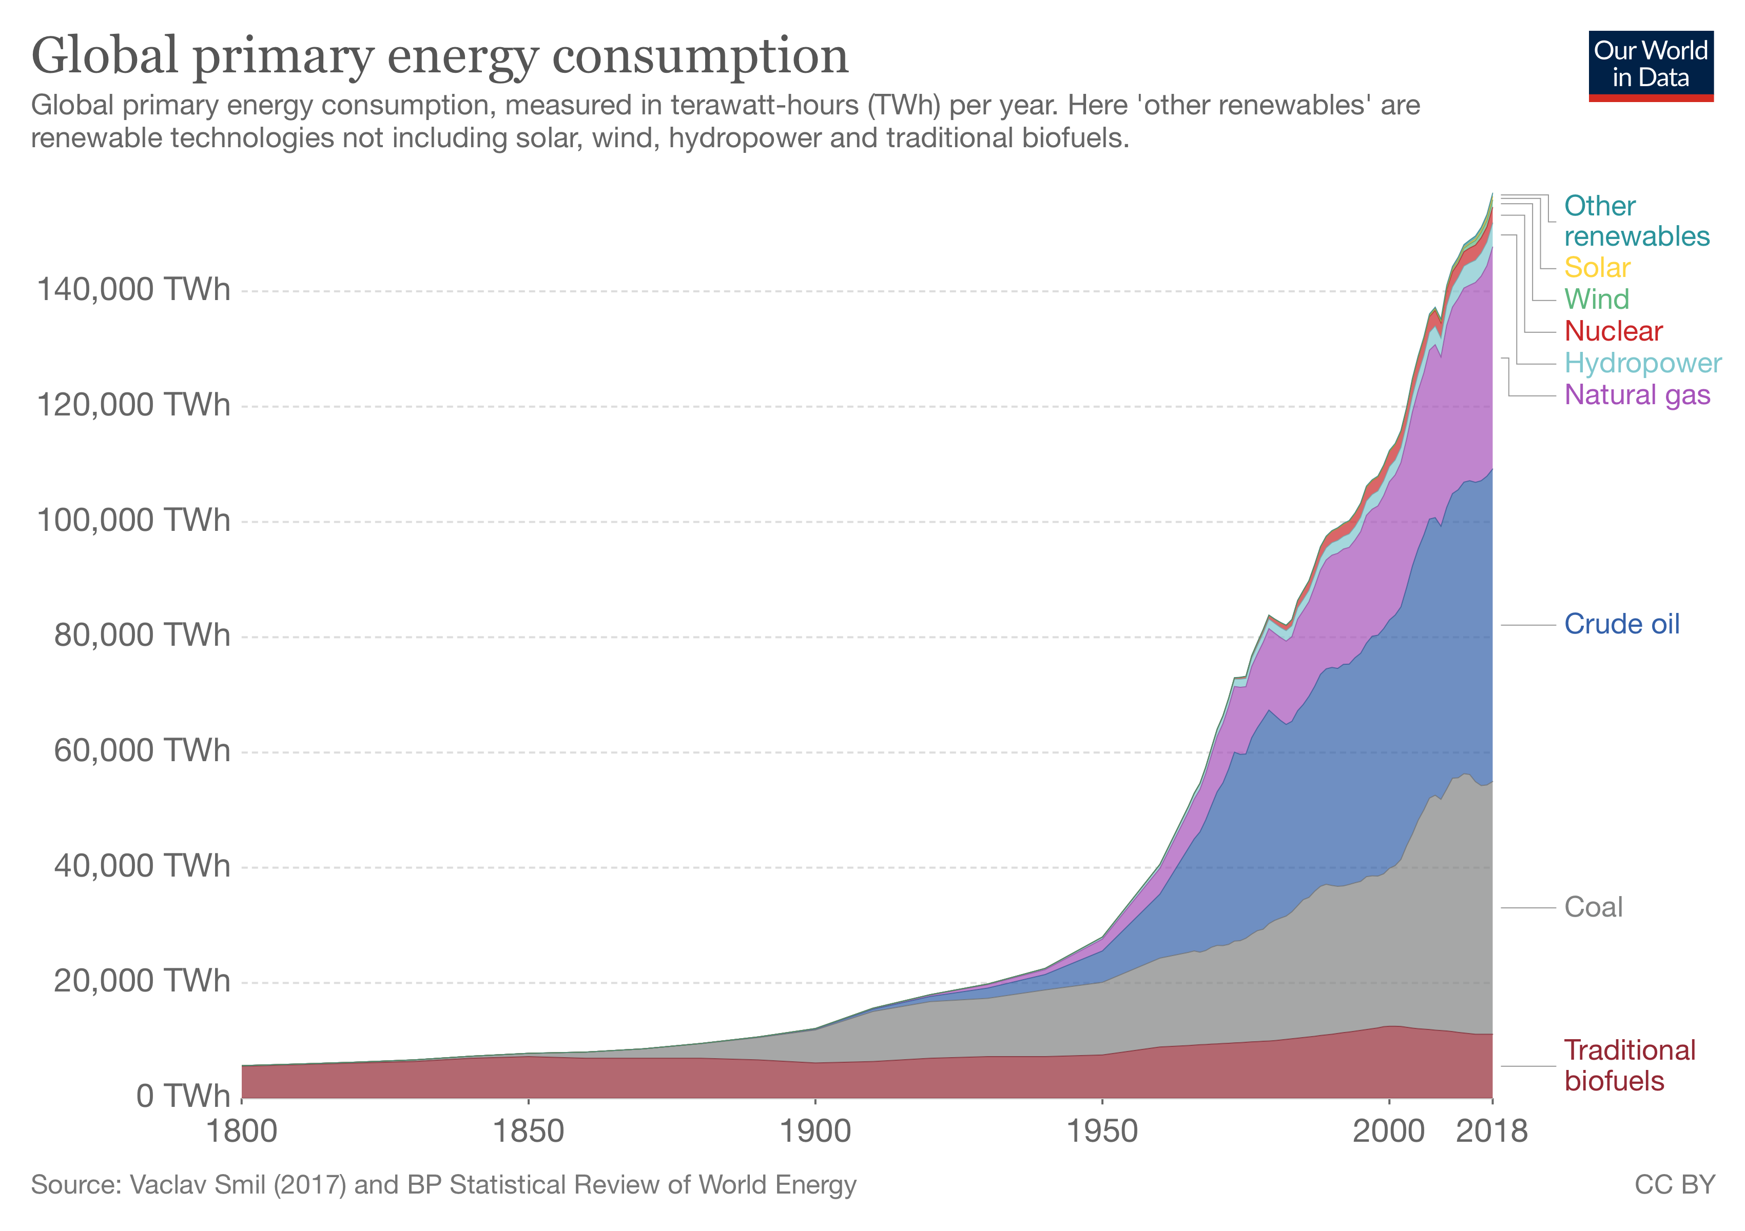
Notes:
If we want to reduce our global greenhouse gas emissions, the world has to transition from an energy system dominated by fossil fuels to a low-carbon one (this is what most countries have set long-term targets to achieve within the Paris climate agreement).
With the exception of carbon capture and storage (CCS) technology (described later in the entry), we have two options to achieve this: renewable technologies (including bioenergy, hydropower, solar, wind, geothermal, and marine energy) and nuclear energy. Both of these options produce very low CO2 emissions per unit of energy compared with fossil fuels. We call this process of transitioning from fossil fuels to low-carbon energy sources ‘decarbonisation’.

Slide 6
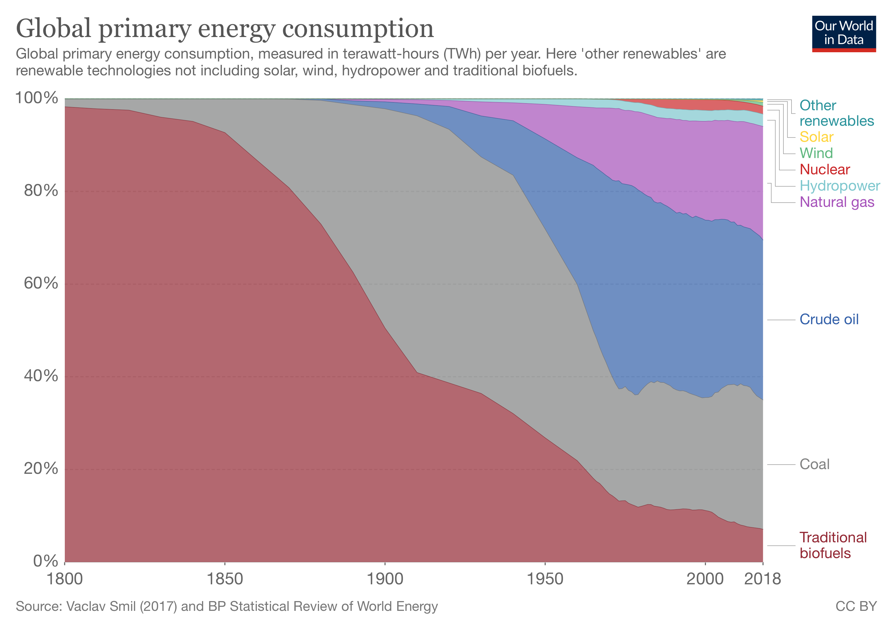

Slide 7
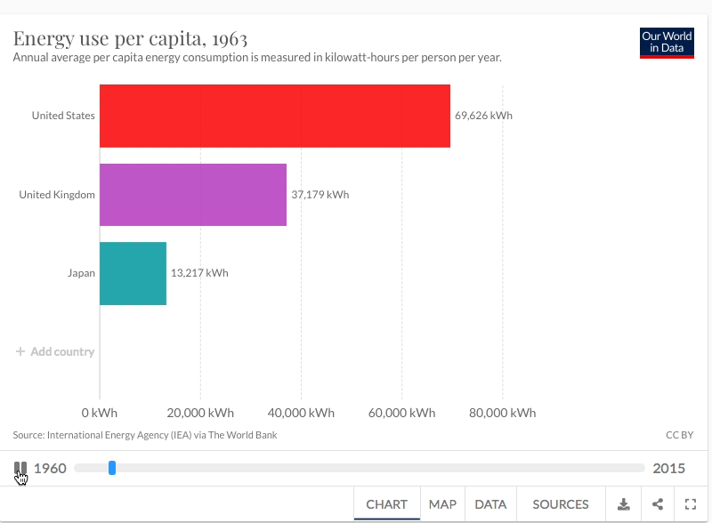

Slide 8
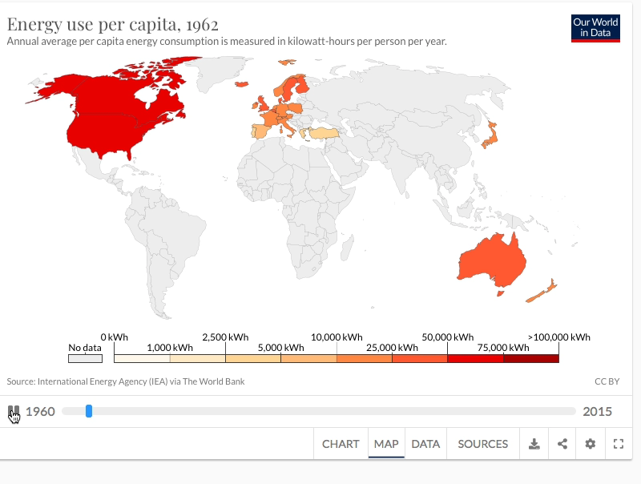

Slide 9
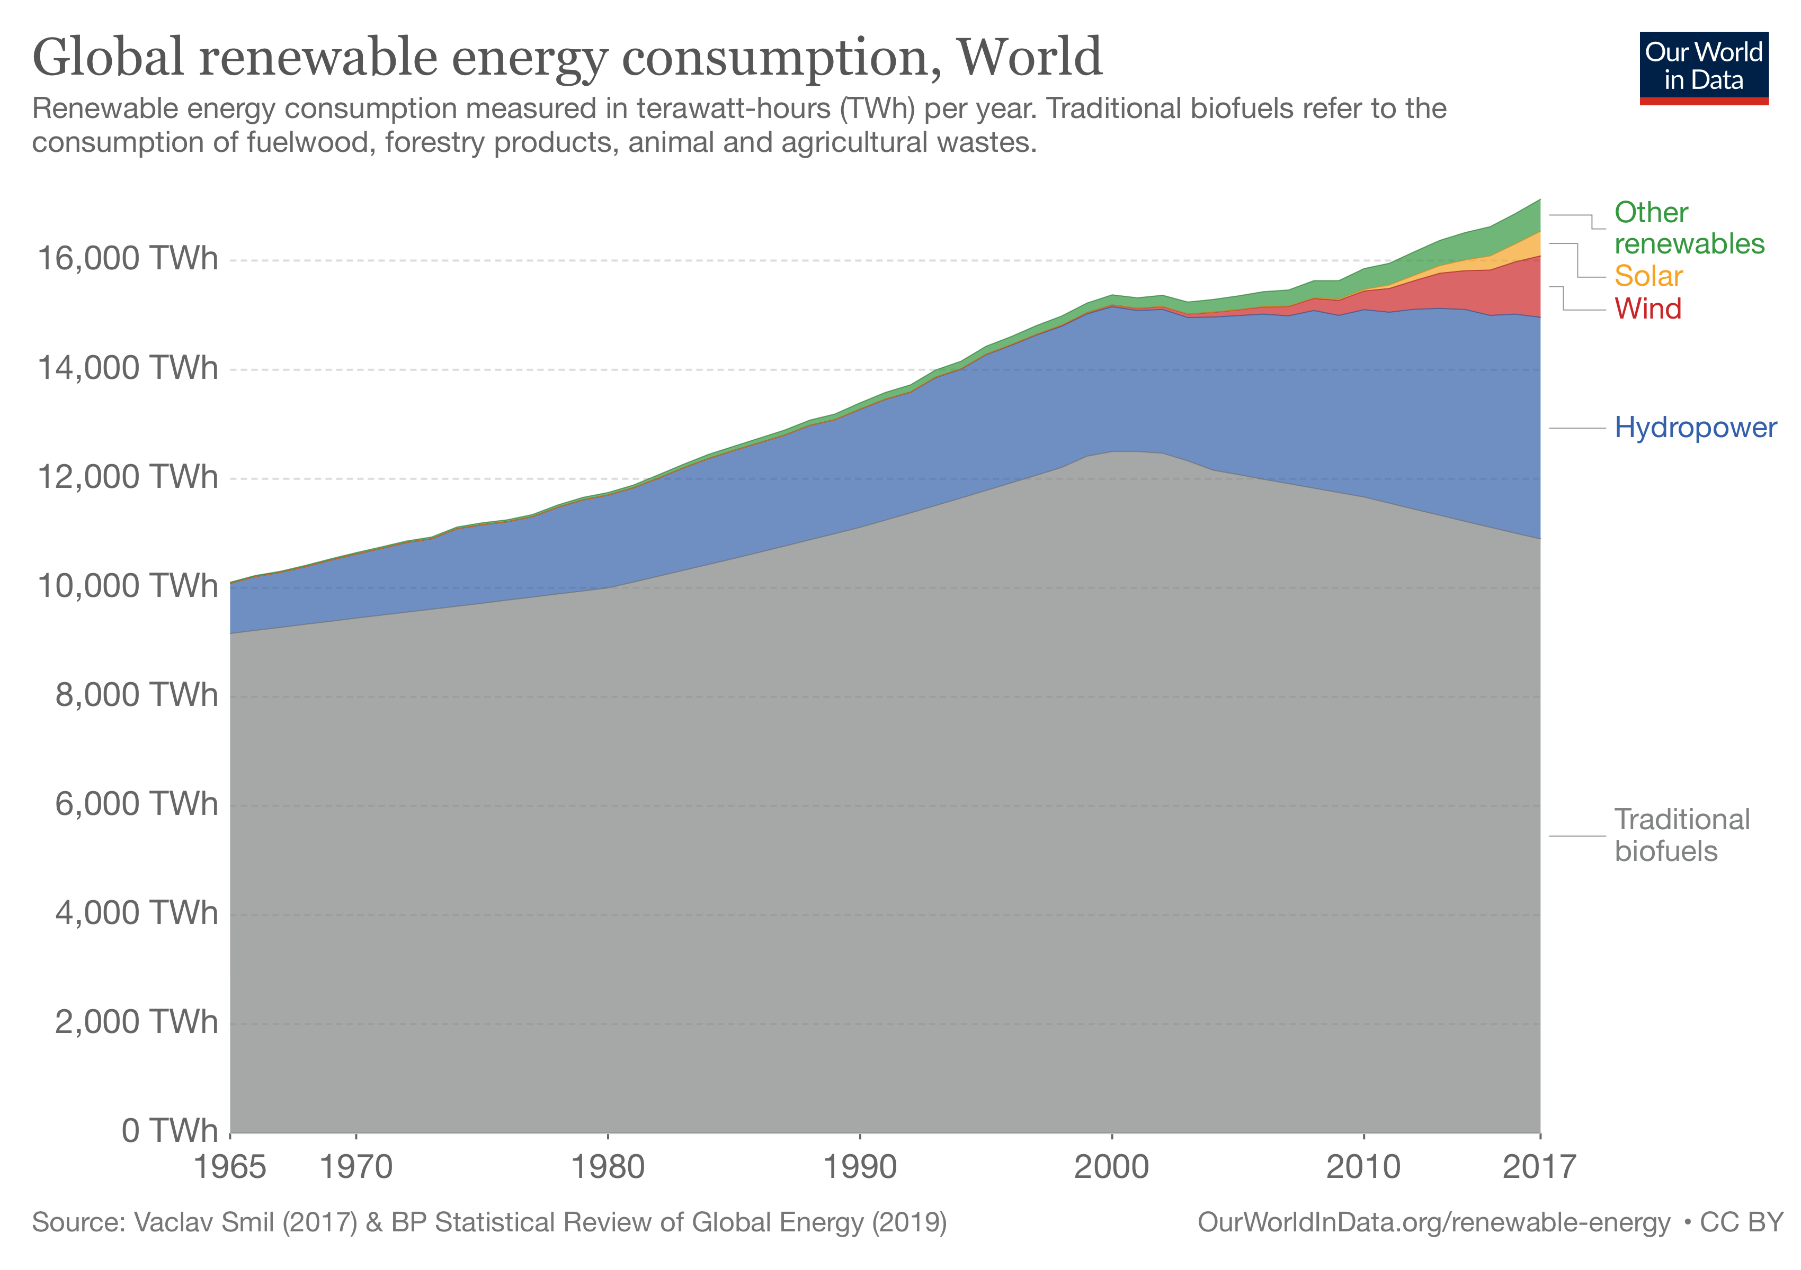
traditional biomass – the burning of wood, forestry materials and agricultural waste biomass
Notes:
Renewable technologies with exception to traditional biomass are often termed ‘modern renewables’. These include hydropower, solar, wind, geothermal and modern biofuel production (including modern forms of waste-to-biomass conversion).
Here we see that hydropower remains the dominant form of modern renewables consumption, accounting for almost 70 percent. Despite absolute growth in production, hydropower’s share is, however, declining as other renewable technologies grow.

Slide 10
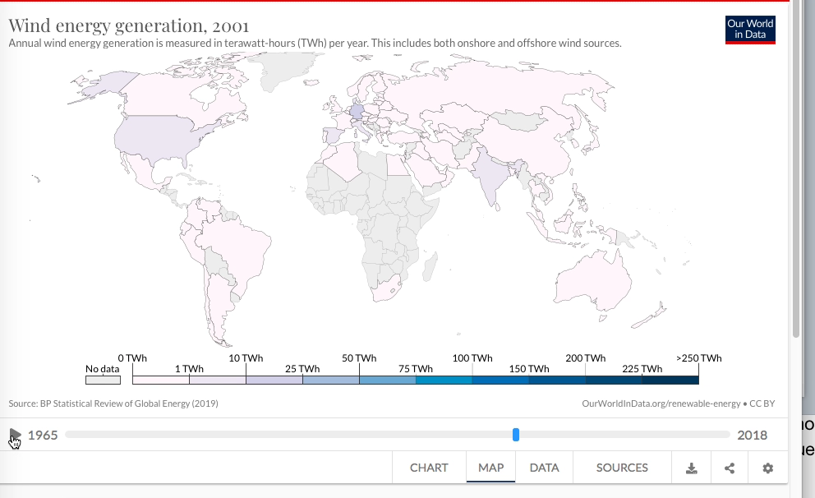

Slide 11
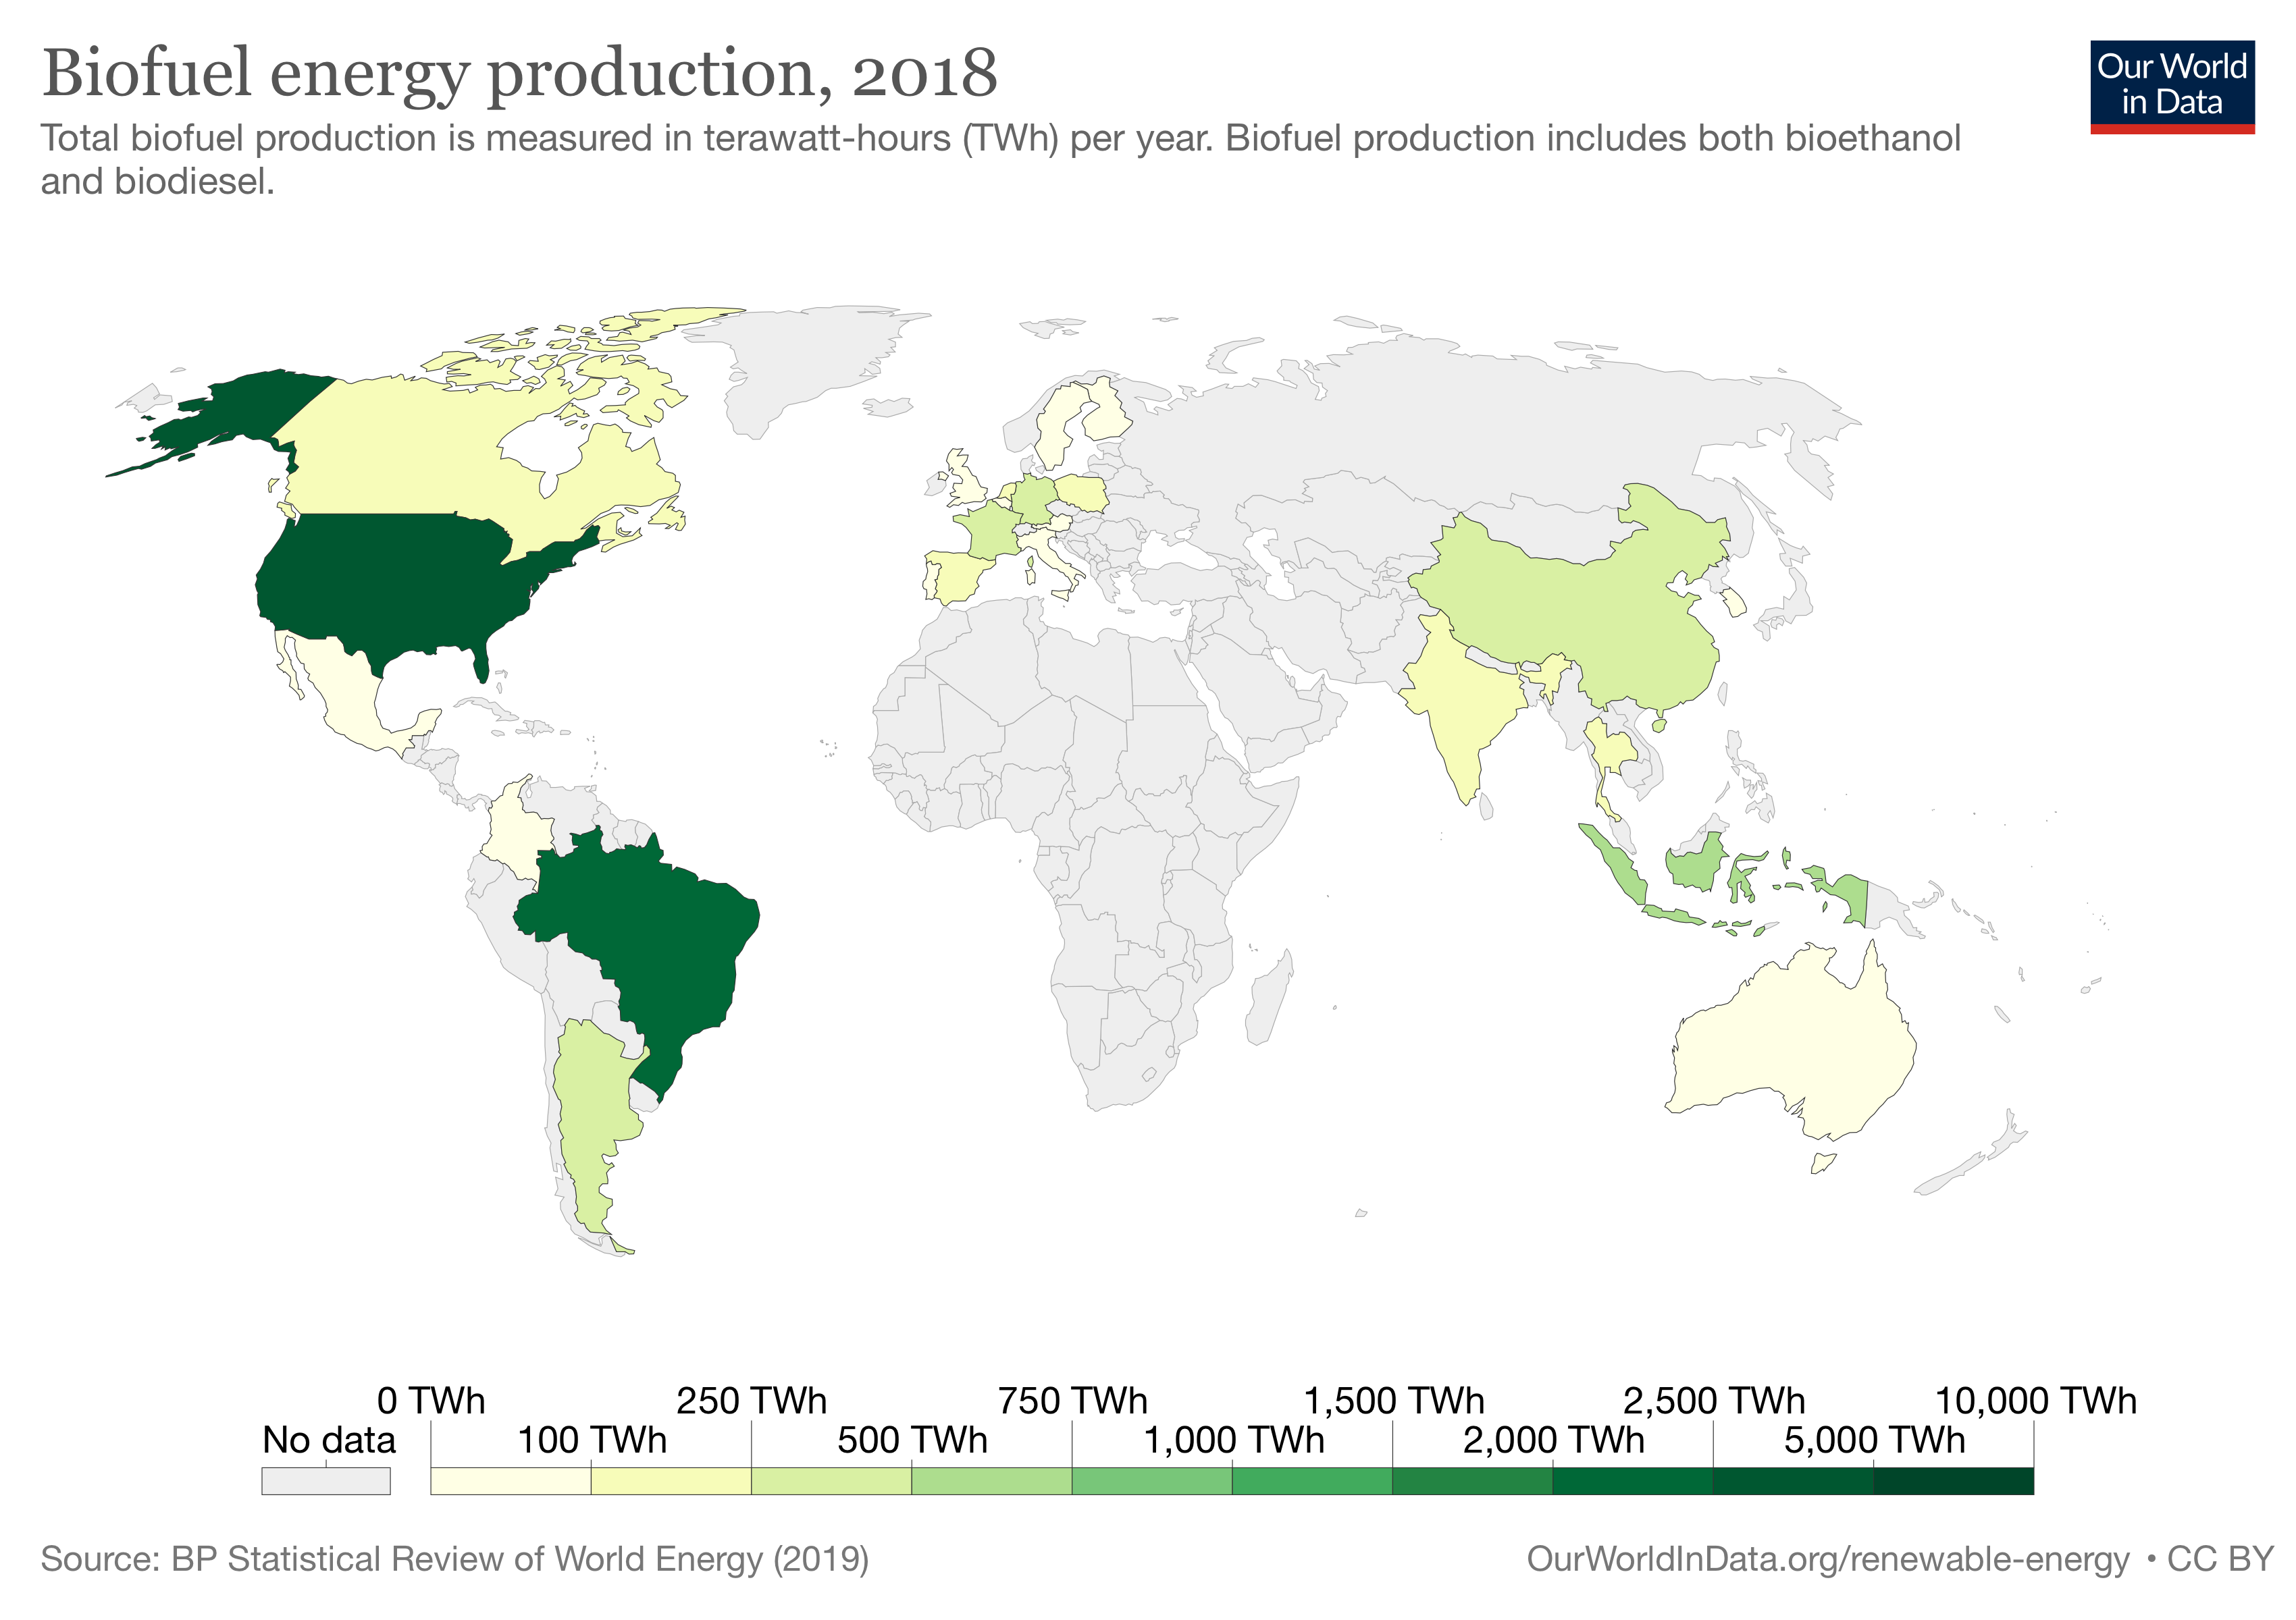

Slide 12
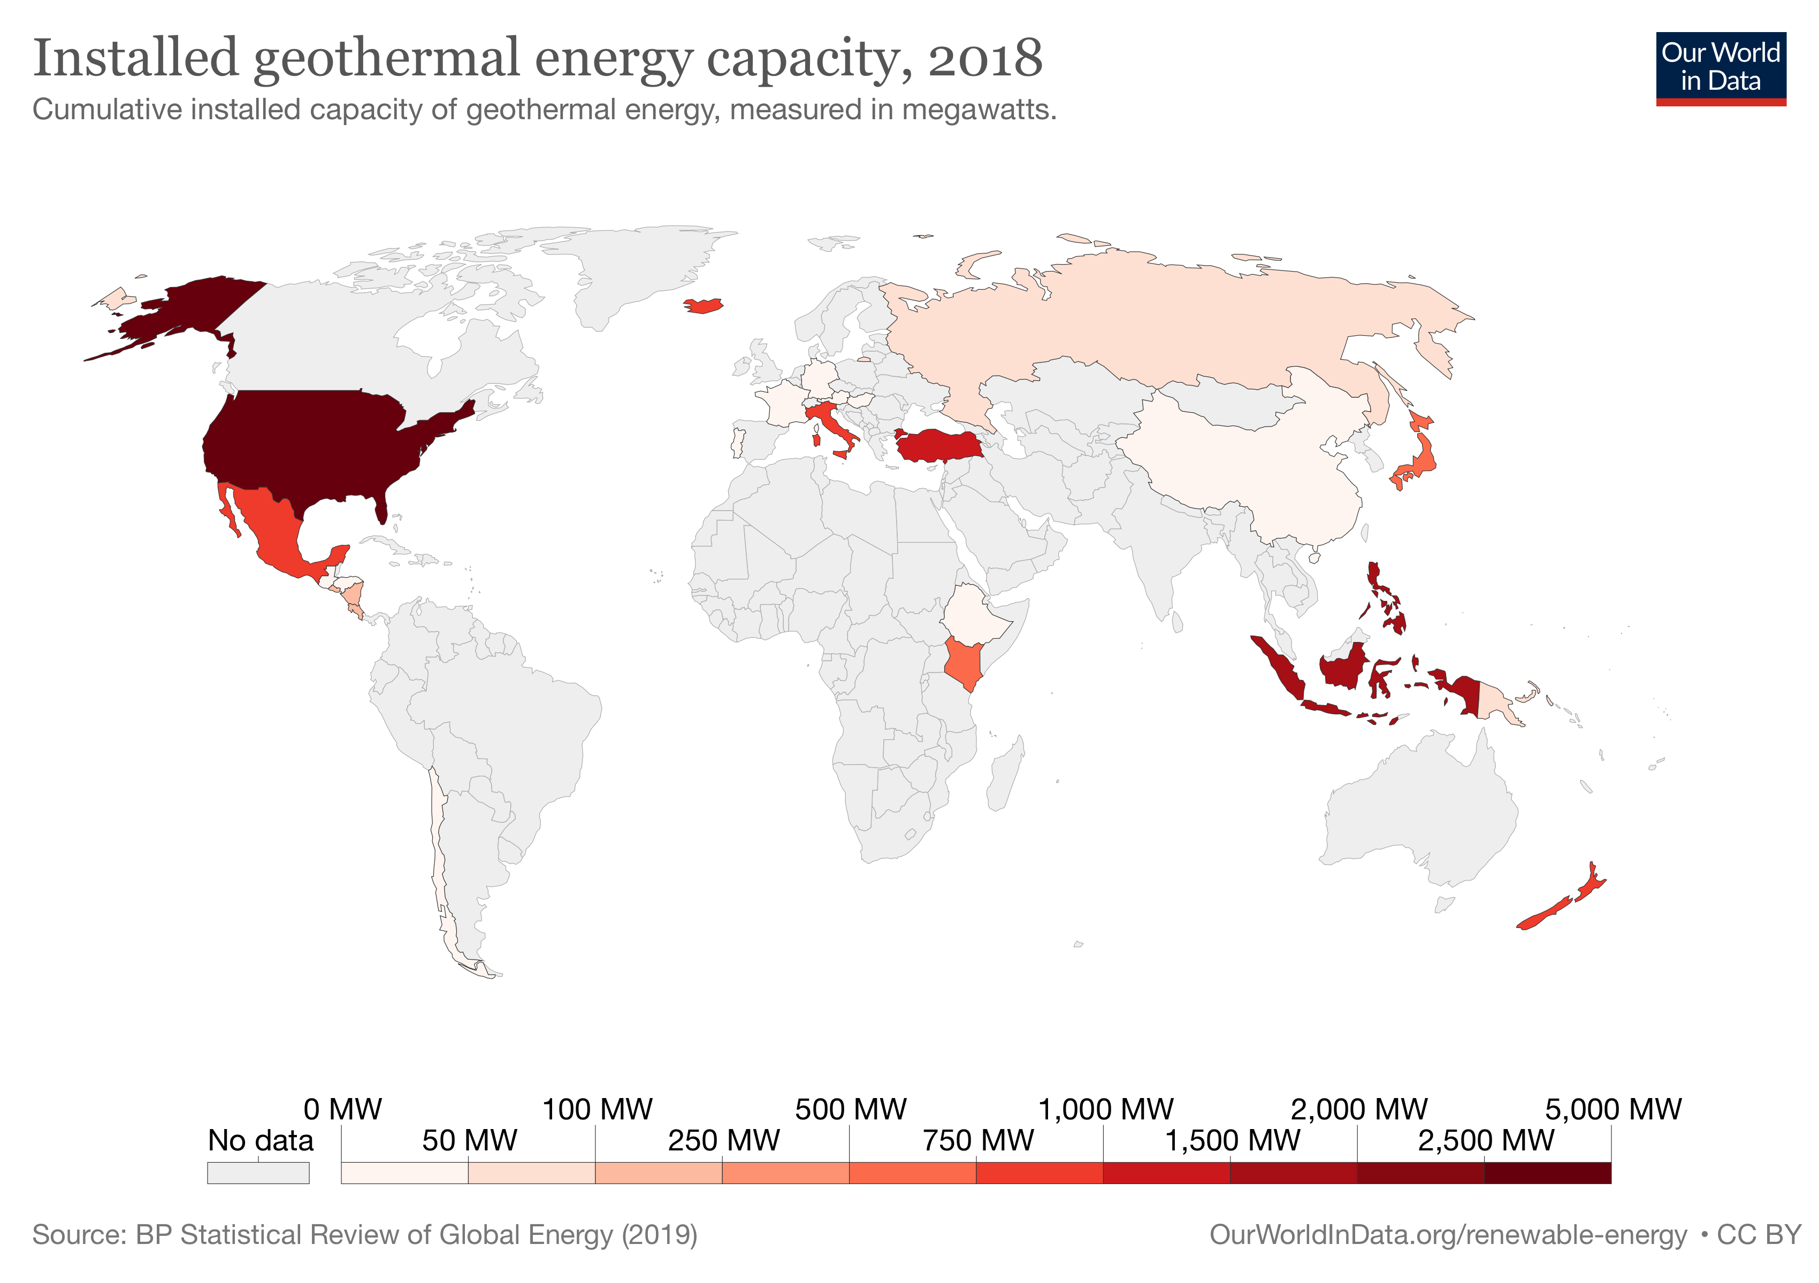

Slide 13
Sustainable development
Definition: Sustainable development means providing for the needs of an increasing human population without harming the environment. (from our syllabus)
Sustainable development is development which meets the needs of the present without compromising the ability of future generations to meet their own needs....— Our Common Future, United Nations World Commission on Environment and Development, 1987
Sustainable development is a general belief that all human endeavors should promote the longevity of the planet and its inhabitants.
Balancing the challenge between development and environment therefore provides us with an ultimate goal of ensuring everyone has access to enough sustainable energy to maintain a high standard of living.

Slide 14
Sustainable development
sustainable development requires:
– management of conflicting demands (business developers/ economic development and the environment)
– planning and co-operation at local, national and international levels (uphold regulations, sign up agreements, etc.)

Slide 15
Sustainable development in architecture
When people construct things, many processes take place to actualize the design. The goal of a sustainable building project is to use materials and processes that will have little impact on the continued functioning of the environment. For example, using local building materials and local laborers limits the pollution effects of transportation. Non-polluting construction practices and industries should have little harm on the land, sea, and air.
Architects should specify materials that do not harm the environment at any stage of their life cycle — from first manufacturing to end-of-use recycling. Natural, bio-degradable, and recycled building materials are becoming more and more common.

Slide 16
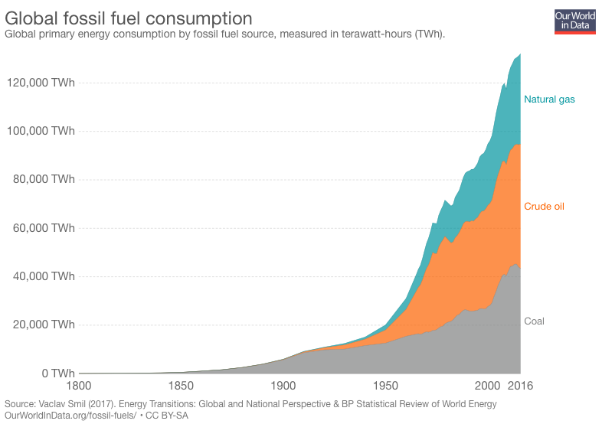
Conservation - resources
Non-renewable resources
By reusing and recycling things that are made from them - glass, plastics, metals, paper
Notes:
Glass - made from sand (silicon oxide), lime (calcium oxide) and soda (sodium oxide); plastics - made from fossil fuels

Slide 17
Conservation - Recycle
Paper. Americans recycled nearly 66 percent of the paper they used in 2017. For every metric ton of paper that is recycled, 17 trees are saved from logging operations.
Glass, especially glass food and beverage containers.
Plastics. More than 35 million tons of plastics were generated in the United States in 2017, while only 8.4 percent of plastics were recycled.
Metals, such as aluminum and steel cans
Batteries & electronics such as laptop, cellphones.
By recycling, we can not only save materials and resources that or else would be used to produce new products, but also reduce carbon emissions and fossil fuels.
https://www.epa.gov/recycle/how-do-i-recycle-common-recyclables

Slide 18
Recycle
The question is, do we have easy access to recycling program, such as municipal curbside program or many drop-off sites?

Slide 19

Conservation - Recycle
Electronics:
Electronic products are made from valuable resources and materials, including metals, plastics, and glass, all of which require energy to mine and manufacture.
Recycling one million laptops saves the energy equivalent to the electricity used by more than 3,500 US homes in a year.
For every million cell phones we recycle, 35 thousand pounds of copper, 772 pounds of silver, 75 pounds of gold and 33 pounds of palladium can be recovered.

Slide 20
Conservation - Reduce, Reuse
Reduction and reuse are the most effective ways you can save natural resources, protect the environment and save money.
Buy used. You can find everything from clothes to building materials at specialized reuse centers and consignment shops.
Look for products that use less packaging.
Buy reusable over disposable items. For example, you can bring your own silverware and cup to work, rather than using disposable items.
Maintain and repair products, like clothing, tires and appliances, so that they won't have to be thrown out and replaced as frequently.
Borrow, rent or share items that are used infrequently, like party decorations, tools or furniture.
Donating. One person's trash is another person's treasure. Instead of discarding unwanted appliances, tools or clothes, try selling or donating them.
Notes:
The most effective way to reduce waste is to not create it in the first place. Making a new product requires a lot of materials and energy - raw materials must be extracted from the earth, and the product must be fabricated then transported to wherever it will be sold.

Slide 21
Conservation - Reduce, Reuse
Reduce wasted food at home
Most people don't realize how much food they throw away every day — from uneaten leftovers to spoiled produce.
In 2017, we disposed 38.1 million tons of food waste.
https://www.epa.gov/recycle/reducing-wasted-food-home

Slide 22
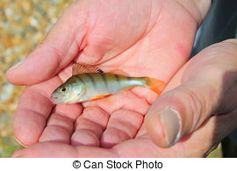
Conserve fish stocks
Impose legal quotas: specify different amounts for different species; not easy to implement
Send inspectors to check fishing activities such as fish catches
Legal regime: International agreement/ treaty
Restocking: breed in fish hatcheries and then release
Education

Slide 23
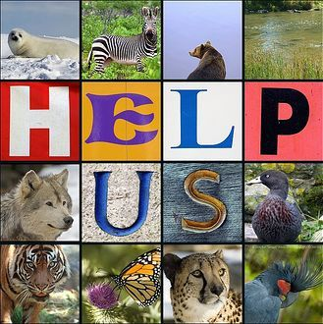
Conservation - endangered species
All of the Earth’s species work together to survive and maintain their ecosystems.
Much of the Earth’s biodiversity, however, is in jeopardy (an unprecedented rise in the rate of species extinction) due to human consumption and other activities that disturb and even destroy ecosystems.
Conservation efforts are necessary to preserve biodiversity and protect endangered species and their habitats.

Slide 24
Conservation research task
Works in pairs or 3 people. Choose a species, either animals or plants, find out their endangered status and related information, stressing on what humans have done to protect/ conserve them.
I list some useful websites here for your conservation programme research presentation.
https://giraffeconservation.org/programmes/
https://www.iucn.org/theme/species/about/iucn-global-species-programme
https://www.iucnredlist.org/about/green-status-species
https://www.nrcs.usda.gov/wps/portal/nrcs/main/national/programs/
https://www.fws.gov/International/wildlife-without-borders/species-programs/
https://www.fws.gov/endangered/what-we-do/index.html
https://conservation.stanford.edu/protecting-threatened-species

Slide 25
Endangered species
Reasons/ causes
climate change (e.g. temperature rises),
habitat destruction/ loss/ fragmentation,
Hunting (by humans)/ poaching,
pollution,
introduced foreign species,
Mass extinction events

Slide 26
Endangered species
Explain the risks to a species if the population size drops:
reducing variation, less chance of surviving if …
Why to conserve endangered species and their habitats?
Humans have no right to endanger other species
Loss of recreation function of ecosystems
Damaging ecosystems will do harm to humans too. (e.g. deforestation, climate change, extreme weather events, soil degradation…)
Losing species can affect widely, such as affecting other species, reduce biodiversity, reduce stability of ecosystems
Potential uses of plants such as medicines or other chemicals, food, fuel
Potentially useful alleles, e.g. for selective breeding programmes

Slide 27
Conservation programmes
Explain reasons for conservation programmes, to include:
– reducing extinction
– protecting vulnerable environments
– maintaining ecosystem functions, limited to nutrient cycling and resource provision, e.g. food, drugs, fuel and genes (potentially useful alleles, e.g. for selective breeding programmes

Slide 28
Conservation programmes
Describe how endangered species can be conserved:
monitoring and protecting species and habitats (including build natural reserves, requires agreement on international cooperation),
education,
Support from law/ regulations/ treaties/ acts, etc. including penalty/ fines if violation occurs,
captive breeding programmes (donate to conserving programmes) and reintroduction,
seed banks (for plants)

Slide 29
Videos
1. https://www.youtube.com/watch?v=JdWQJq2OkJs
WWF, our planet: our business
2. Why is biodiversity so important - Kim Preshoff.mp4
3. Reviving a Great Lakes Wetland.mp4
Great Lakes restoration from with lead and petroleum hydrocarbons
4. 50 Years Ago, This Was a Wasteland. He Changed Everything Short Film Showcase.mp4
David Hamburger, restore overgrazed land in the Texas Hill Country

